Slide 1
CGB1201 – JAVA PROGRAMMING
Department of Artificial Intelligence and Data Science
Academic Year: 2024 – 2025 (Odd Semester)
Register Number :2303811724321111
Name :SUDHAKARAN M
Year :II
Semester :III
Section :B
Date :03/12/2024

Slide 2
Title of the Project
ELECTRICITY BILLING SYSTEM

Slide 3
Problem Identification
The TNEB Electricity Billing System manages customer data and billing effectively but lacks input validation, data persistence, and robust error handling, making it prone to crashes and data loss. Its flat-rate billing logic, fixed GUI, and tightly coupled design limit scalability, usability, and maintainability. Adding validation, persistent storage, and enhanced billing and UX features would greatly improve its reliability.

Slide 4
Objective
The objective of the TNEB Electricity Billing System is to provide an efficient and user-friendly platform to manage customer information, record meter readings, calculate electricity bills, and track payment statuses, streamlining the billing process for both administrators and consumers.

Slide 5
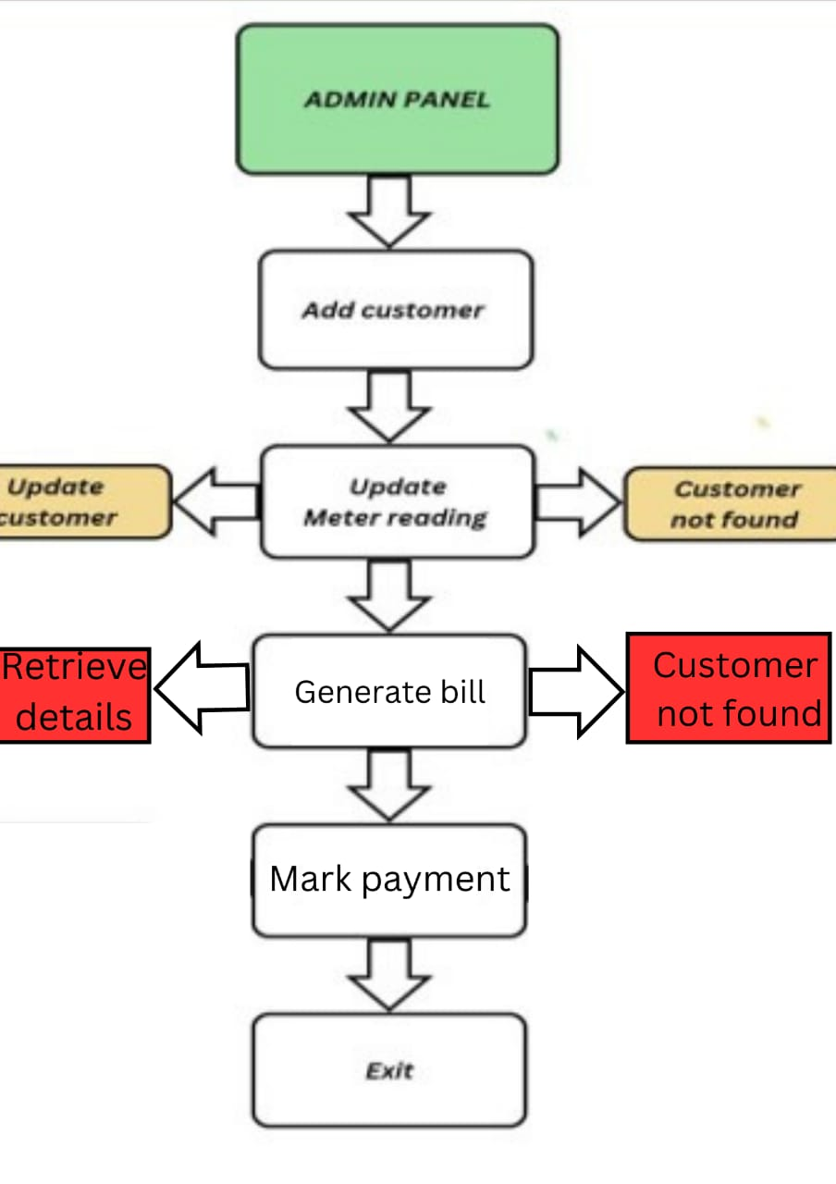
Proposed Architecture

Slide 6
Java Programming - Concepts Used
Classes and Objects: Used for structuring the program (e.g., Customer and AdminPanelGUI).
Encapsulation: Protects data through private fields and public methods.
Exception Handling: Manages invalid inputs using try-catch blocks.
Swing GUI: Provides a graphical interface with JFrame, JButton, etc.
Data Structures: HashMap stores and retrieves customer data efficiently.

Slide 7
List of Modules
Customer Management Module
Meter Reading Module
Billing Module
Payment Tracking Module
User Interface (GUI) Module

Slide 8
Module Description
Customer Management Module: Handles customer data like name, meter number, phone, and address.
Meter Reading Module: Records and validates meter readings to calculate consumed units.
Billing Module: Computes electricity bills based on tiered rates for consumption.
Payment Tracking Module: Tracks the status of payments (Paid or Pending) for bills.
User Interface (GUI) Module: Provides an interactive GUI for managing customers, readings, and bills.

Slide 9
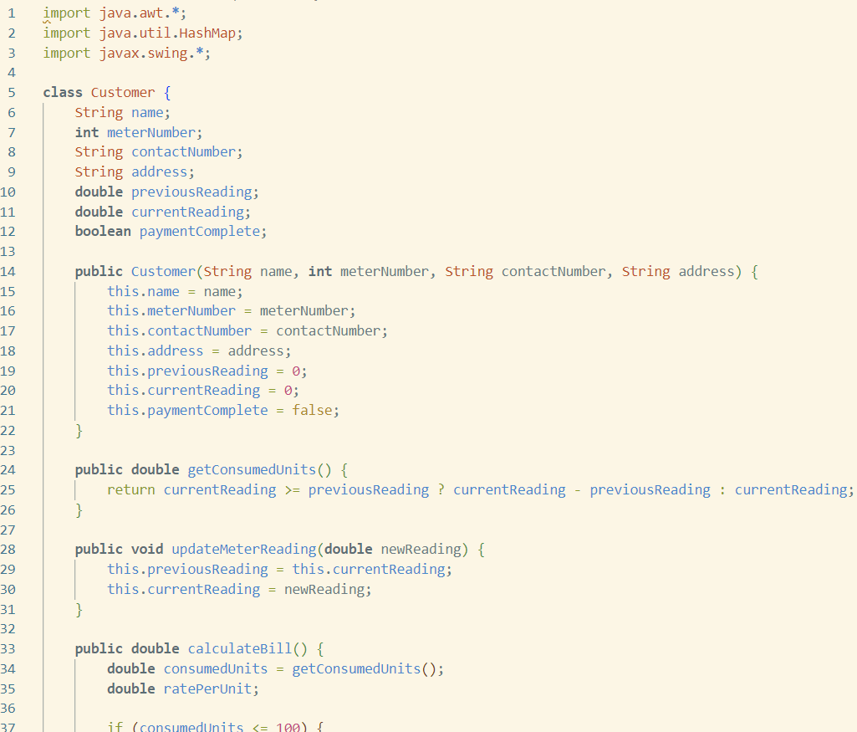
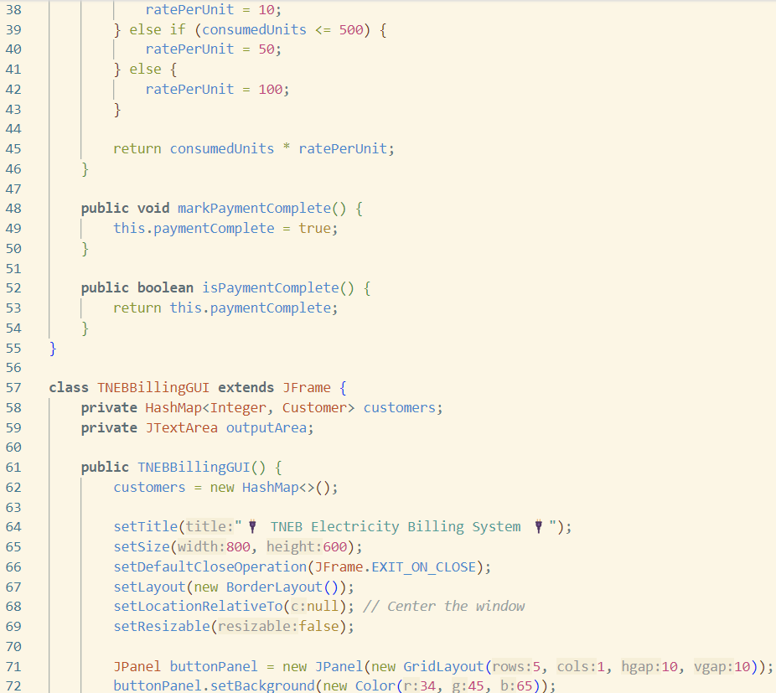
Source Code

Slide 10
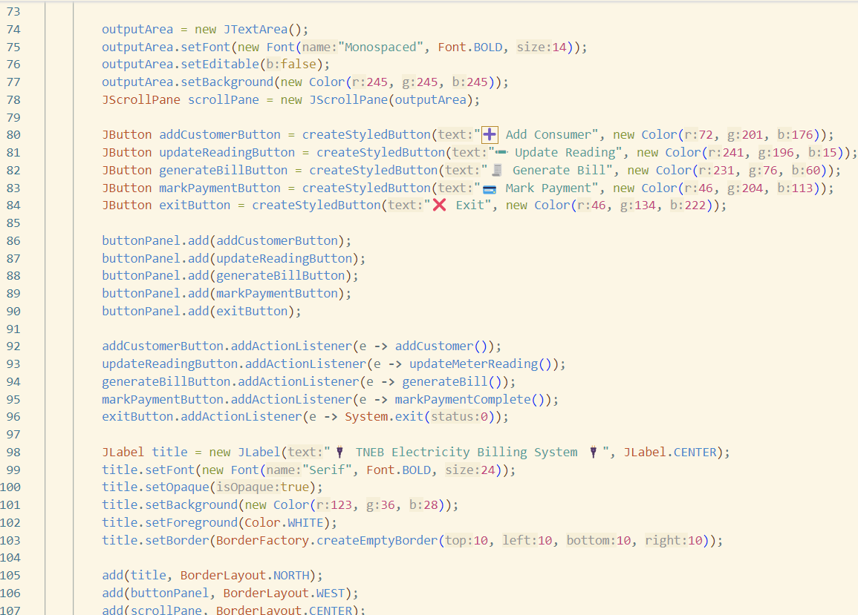
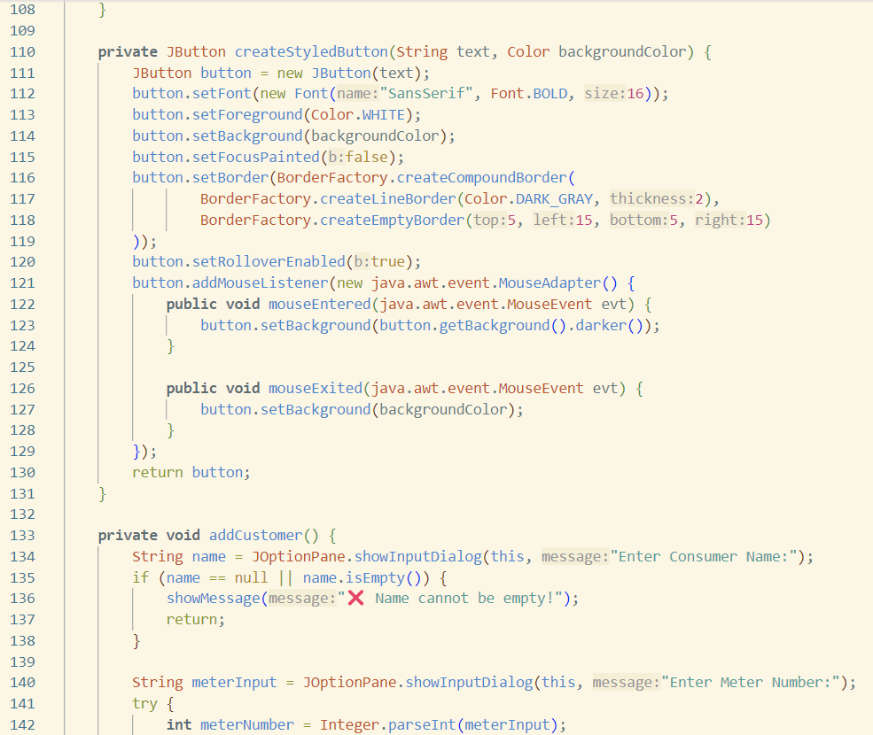
Source Code

Slide 11
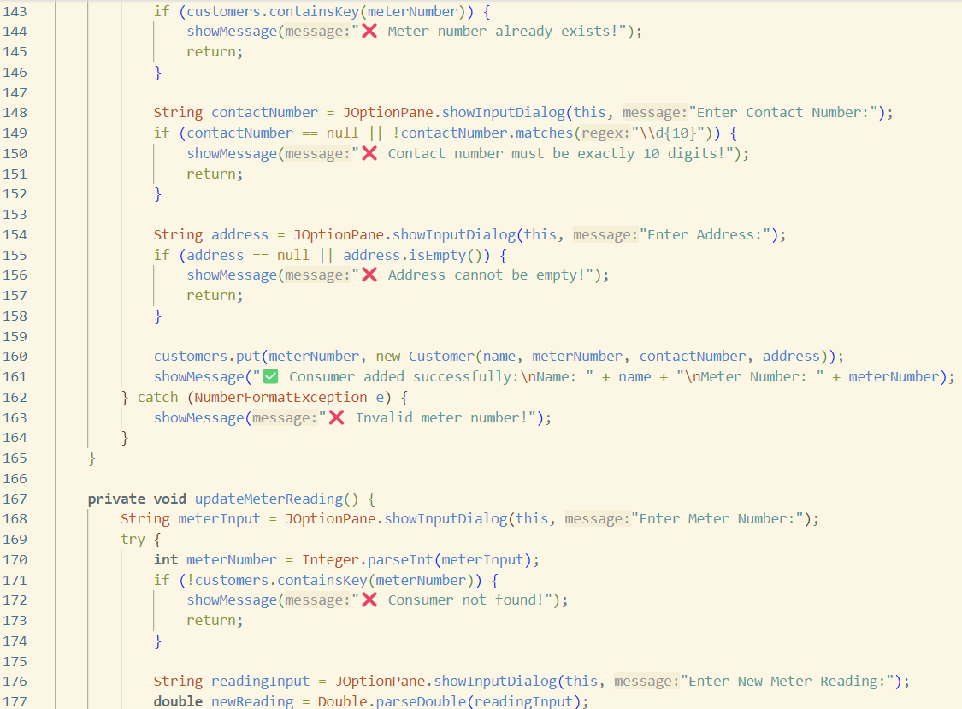
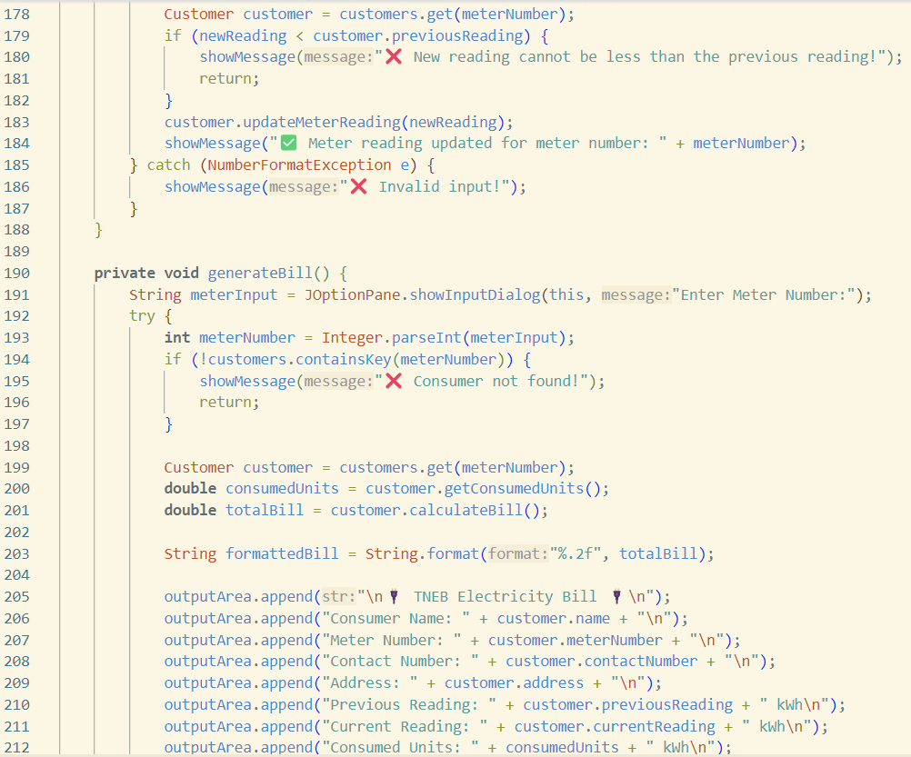
Source Code

Slide 12
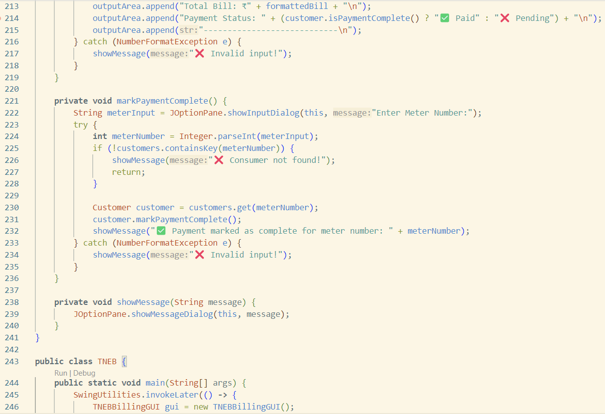
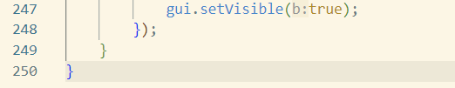
Source Code

Slide 13
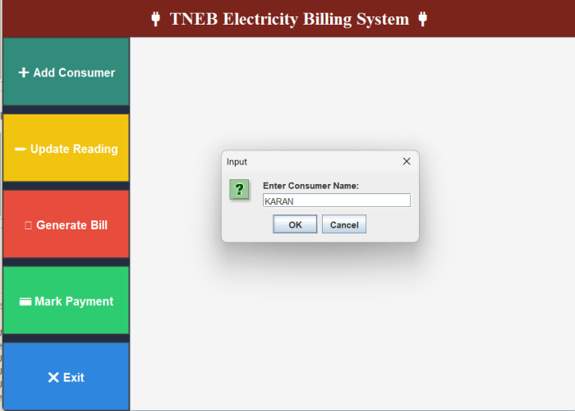
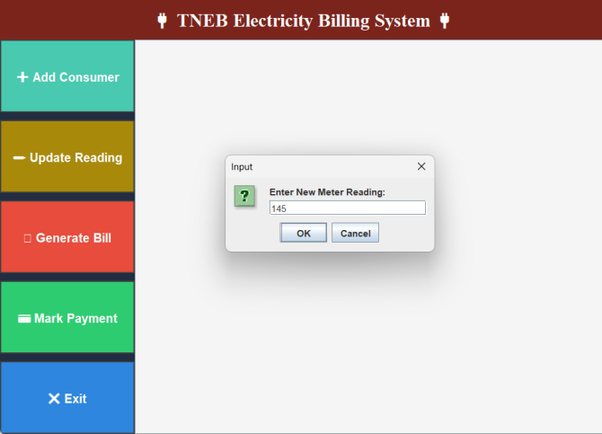
Results

Slide 14
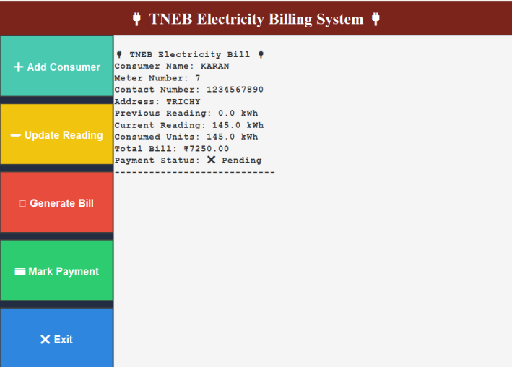
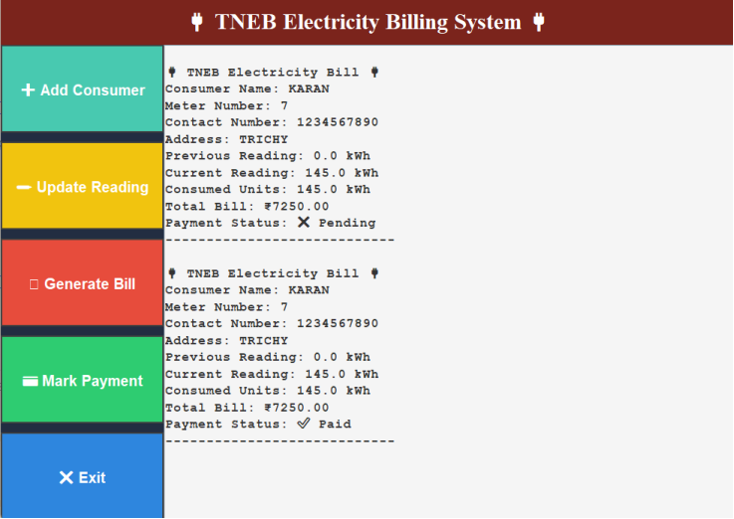
Results

Slide 15
Conclusion
The TNEB Electricity Billing System effectively automates the electricity billing process, ensuring accuracy and efficiency in customer management, meter reading, bill generation, and payment tracking. By utilizing core Java programming concepts and a user-friendly GUI, the system simplifies administrative tasks and reduces errors. Its modular design ensures scalability and maintainability, making it a robust solution for streamlining electricity billing operations.

Slide 16
Thank You
Any queries???

